Slide 1
Options & Bundle Discount

Slide 2
Version History
Version | Version Date | Revised By | Reviewed By | Approved by | Reason For change
0.1(Draft) | 15th Oct 2019 | Kamlesh Yadav Sandip Khairnar |  |  | First draft.
0.2(Draft) | 18th Oct 2019 | Kamlesh Yadav Sandip Khairnar |  |  | Changes as per internal Review.
0.3(Draft) | 23th Oct 2019 | Kamlesh Yadav Sandip Khairnar |  |  | Changes as per review with business stakeholders. - Addition of Individual Option in Options Quote. - Updates to make use cases more clear.

Slide 3
TOC
Objective/Requirements
Assumptions, Risks & Dependencies
Key Design Decisions
Issues
Generic Capabilities
Options Quote
Project Quote
Price Lookup Enhancements
Use Cases (Options Quote)
Use Case 1a: Options Quote (Same OCN & Same Opportunity), All Line items Ordered at same time for same OCN)
Use Case 1b: Options Quote (Same OCN & Same Opportunity), All Line items Ordered at same time for same OCN). First Option is discarded after it is initiated for Technical Review.
Use Case 2: Options Quote (Same OCN & Same Oppt for line items (Ordered at diff time))
Use Case 3: Options Quote (Diff OCN & Diff Oppt for line items (Ordered at diff time))(Wholesale only)
Use Case 4: Options Quote (Same OCN & Same Opp for line items (Ordered at same time))(Wholesale only)
Use Case : Options Quote (Same OCN & Same Opportunity , Diff OCN for line items (Ordered at same time)) – Global Deals workaround will be defined (De-scoped)
Use Cases (Bundle Quote) –(Wholesale specific)
Use Case 1: Bundle Discount(individual pricing and combined pricing in same quote) – Individual price line ordered
Use Case 2: Bundle Discount(individual pricing and combined pricing in same quote - Combined option ordered at same time)
Use Case 3: Bundle Discount(individual pricing and combined pricing in same quote - Staggered delivery for combined option ordered)

Slide 4
Objective/Requirements
Following are the key high level points covered in this design.
Options
Sales requires a functionality that shall allow them to easily configure multiple pricing options for one or more products.
The creation of this functionality shall allow all sales users to present to their customers pricing for different options related to contract terms, bandwidth or resilience for each of the line items.
This functionality shall allow users to configure all multiple options line items within a single quote and a single opportunity.
Deal Pricing approvers should be able to calculate the margin and upload the financials in the system for each of the options.
Deal Pricing team and approvers should be able to approve or reject options individually.
Customer will pick only one of the options. Sales should be able to submit the customer preferred option for technical review.
Sales should be able to submit the accepted option to Order.
Bundle Discount
A functionality is required that shall allow users to configure within the system quote requests for multiple products that require a discount as a bundle.
The discount approval shall be done for all line items included within the request but sales users shall have the ability to submit to order each line item individually and at different times.
This functionality shall allow sales users to submit the request for bundled discount to Deal Pricing without requiring an Opportunity.

Slide 5
Assumptions, Risks and Dependencies
S.No | Date | Assumption | Status | Stakeholders
S.No | Date | Risks | Status | Stakeholders
 | 15/11/2019 | After Initiating Technical Review from project Quote if any commercials are changed(due to addition/deletion of Features/Products) during Technical Review then same is not reflected back in Opportunity linked with project Quote. Mitigation: Once Tech Review is initiated and new Quote is created, always use child Quote for any commercial information. | Closed | Piyush V, Lucka, Dimas
S.No | Date | Dependencies | Status | Stakeholders

Slide 6
Key Design Decisions
S.No | Date | Design Decision | Stakeholders
1 | 24/10/2019 | Only one ‘Individual’ Option is available to group all the circuits where individual circuit level deiscoutn is applied. | Piyush V, Lucka, Marcus, Richard, Dimas

Slide 7
Issues
S.No | Date | Issue | Status | Stakeholders

Slide 8
Design Approach
There are multiple business scenarios which needs to be supported.
Considering multiple use cases and its complexity, new generic capabilities have been designed/developed which can be used to fulfil different business use cases. This would avoid building Bespoke workflows and capabilities can be used in more generic manner to fulfil the business scenarios.

Slide 9
Generic Capabilities
Capabilities which are required to support Options Quote and Bundle discount. Idea is to design/develop these as generic functions so it can be used to fulfil different business scenarios.

Slide 10
Options Quote Capability Details

Slide 11
Options Capability : Overview
Same OCN & Same Opportunity(if Present)
New Standard Quote is created in Commercially Approved stage.
All standard quote stage(Stage, Quote ID) would get reflected in Parent options quote.
if Options Quote is linked with Opportunity, same Opportunity is used to create Standard Quote.
If Options Quote is Price Lookup quote, then Standard quote is also created as price lookup quote.
OCN, Opportunity (Optional)
Commercially Approved
Sales
Create Quote.
Set Options Quote Flag
Sales
(Create Options, Apply Discount)
Deal Approval
Sales
(Commercially Approved)
Standard Quote-1
QL-1,QL-2,QL-3
Options Quote-1
QL-1
QL-2
QL-3
QL-4
QL-5
QL-6
QL-7
QL-8
QL-9
Options Quote-1
Option -1
QL-1,QL-2,QL-3
Options Quote-1
Option -1
QL-1,QL-2,QL-3
Options Quote-1
Option -1
QL-1,QL-2,QL-3
(Commercially Approved)
It enables to group line items in multiple options.
Can be used in Standard & Price Lookup Quote.
Price lookup Quote can be sent to Deal only for Wholesale Customers & if its (at option level) Bronze or Bronze+. For Higher Deal classes Opportunity is must.
Deal would get visibility of all the options and need to work at the option level.
Upload MMT at the Option level.
Approve/Reject at the option level.
Approve/Reject the overall Quote.
After Commercial Approval individual journey (i.e. Technical Review & Ordering) needs to be followed for each option.
Technical review is initiated only at Option level, it can’t be done at line item level.
User can initiate Technical Review for any of the Approved Option.
User can progress more than one option for technical Review if required.
Options Quote-1
Option -2
QL-4,QL-5,QL-6
Options Quote-1
Option -2
QL-4,QL-5,QL-6
Options Quote-1
Option -2
QL-4,QL-5,QL-6
(Commercially Approved)
Options Quote-1
Option -3
QL-7,QL-8,QL-9
Options Quote-1
Option -3
QL-7,QL-8,QL-9
Options Quote-1
Option -3
QL-7,QL-8,QL-9
(Approval Denied)

Slide 12
Options Capability : Key Points
Options is enabled by setting a Flag on Quote.
This flag is available before Commercial Approval process is initiated i.e. till Quote is submitted for Approval. Post commercial approval its read-only.
It enables to group line items in different options.
Flag can be Set/Reset before any Option is initiated for Commercial Approval. Options marking is retained after Flag is set/Reset.
Can be used in following type of Quotes
Standard Quote
Price Lookup Quote
Price lookup Quote can be sent to Deal only for Wholesale Customers & if its (at option level) Bronze or Bronze+. For Higher Deal classes Opportunity is must.
If quote is sent to Deal, Deal would get visibility of all the options and need to work at the option level.
Upload MMT at the Option level.
Should Approve/Reject at the option level.
Should Approve/Reject the overall Quote.
After Deal Governance, if Quote is Approved its status is changed to ‘Commercially Approved’.
After ‘Commercially Approved’ stage individual journey (i.e. Technical Review & Ordering) needs to be followed for each option.
Only Commercially Approved Options can be progressed further for Technical Review & Ordering.
Technical review is initiated only at Option level, it can’t be done at line item level.
User can initiate Technical Review for any of the Approved Option.
New standard Quote is created in ‘Commercially Approved’ stage.
All the standard Quote features are available in new Quote.
All standard quote stage(Stage, Quote ID) would get reflected in Parent options quote.(MQ model is followed to sync data back to options quote)
User can progress more than one option for technical Review if required.
If Options Quote is linked with Opportunity, same Opportunity is used to create Standard Quote.
If Options Quote is Price Lookup quote, then Standard quote is also created as price lookup quote.

Slide 13
Options Capability : Key Points Cont.…
Expired Quote
Scneario1 – If none of the options is initiated for technical review
Use Refresh Quote OR
Admin capability to reset expiry date (on the same stage)
Scneario2 – if one of the option is initiated for technical review
Admin capability to reset expiry date (on the same stage)
Synchronisation between C4C & CPQ
Only Primary option details are synched with C4C not the entire quote.
Following are the rules to determine the primary option
By Default option1 is marked as primary.
System would give an option to select the primary option.
Once standard quote/s are created for the approved options then which ever quote is Accepted by Customer would become the primary quote for the opportunity. C4C picks the data from the primary quote and apply business rules. (BAU)

Slide 14
Options Capability : Key Points Cont.…
For CPQ Journey Details pls use this link
Revise Quote
Not applicable.
Revise Commercial
If any one of the options is initiated for technical review then “Revise Commercial” is not allowed on options quote.
Else Quote stage changes to “Priced”, discount and financials(P&L) will be retained for Commercially Approved options by deal.
Option level approve and reject response will get wipe out.
Commercially Approved options wont show in reasons table.
After submitting quote to deal, options level approval required for commercially approved options without MMT journey.
In case of reconfigure after revise commercials then discount and key financials are getting wipe out which might require deal pricing approval again.

Slide 15
Project Quote Capability Details

Slide 16
Standard Project Quote : Overview
Standard Project Quote (OCN1, Opp1)
Set Project Flag
Allow users to order(Initiate Technical Review) line items from the same quote at different times by creating new Standard Quote.
New Standard Quote is created in ‘Commercially Approved’ stage.
Same Opportunity is used for creating new Quote.
Once any line item is initiated, “Project Quote” Flag can’t be changed.
Project Quote capability is not available for Options Quote.
Standard Quote (OCN1, Opp1)
Sales
Create Quote
Sales
(Commercially Approved)
Fast Sign Process
(Mandatory)
Initiate Technical Review
Commercially Approved
Staggered Delivery
QL-1
QL-2
QL-3
QL-4
QL-1
QL-2
QL-3
QL-4
QL-1
QL-2
QL-3
QL-4
QL-1
QL-2
QL-3
QL-4
Day 1
Std Quote-S1
Ql-1
Day 2
Std Quote-S2
QL-2, QL-3
Day 3
Std Quote-S3
QL-4
Opportunity Closure
While initiating technical review.
Project Quote closure
When all line items of Project quote have reached ‘Ordered’ stage.
Standard Quote closure
When respective Standard Quote reaches ‘Ordered’ stage.
New Quote is Created on closed Opportunity.

Slide 17
Price Lookup Project Quote : Overview
New Opportunity is created for each standard Quote.
Fast Sign process can’t be used in Price Lookup Quote.
Price lookup with project flag can be submitted to deal pricing only for wholesale channel(Bronze, Bronze+ deal). For higher value deals opportunity is must.
Price Lookup Project Quote can’t be associated with Opportunity.(c4c)
Opportunity Closure
Opportunity for each Standard Quote is closed when underlying Quote reaches ‘Accepted by Customer’ stage.
Project Quote closure
When all line items of Project quote have reached ‘Ordered’ stage.
Standard Quote closure
When respective standard Quote reaches ‘Ordered’ stage.
Price Lookup Quote (OCN1)
Set Project Flag
Standard Quote (OCN1)
Sales
Create Quote
Sales
(Commercially Approved)
Sales
(Initiate Technical Review)
Commercially Approved
Staggered Delivery
QL-1
QL-2
QL-3
QL-4
QL-1
QL-2
QL-3
QL-4
QL-1
QL-2
QL-3
QL-4
Day 1
Std Quote-S1
Ql-1 (OCN1, Opp1)
Day 2
Std Quote-S2
QL-2, QL-3
(OCN1, Opp2)
Day 3
Std Quote-S3
QL-4
(OCN1, Opp3)
New Opportunity is created for each standard Quote.

Slide 18
Project Quote Capability – Key Points
It’s a generic capability which allow users to order(Initiate Technical Review) line items from the same quote at different times by creating new Standard Quote.
It enables to
Initiate Technical Review at Line item level (at different time).
New Standard Quote is created in ‘Commercially Approved’ stage.
Line level Commercial Details(Price and discount) are carried forward in new Quote. MMT files is not carried forward in standard quote.
If Opportunity is present on Project Quote same Opportunity is used for creating new Quote else new opportunity is created.
If Opportunity is present on Project Quote, Fast sign process must be used before initiating technical review. If Opportunity is not present on Project quote then Fast sign process won’t be available. Since Opportunity is closed, newly created quote wont sync back to Opp.
At the Quote level, Existing OCN is carried forward in initiated quote.
It can be used (By setting a flag on UI) for following type of Quotes.
Standard Quote
Price Look-up Quote
Project Quote flag
Is defaulted to false
It can be set before initiating technical review.
Once any line item is initiated, “Project Quote” Flag can’t be changed.
Is not available for Options Quote.
Price lookup with project flag can be submitted to deal pricing only for wholesale channel(Bronze, Bronze+ deal). For higher value deals opportunity is must.

Slide 19
Project Quote Capability – Key Points Cont.
For CPQ Journey Details pls use this link
Expired Quote
Scneario1 – If none of the options is initiated for technical review
Use Refresh Quote OR
Admin capability to reset expiry date (on the same stage)
Scneario2 – if one of the option is initiated for technical review
Admin capability to reset expiry date (on the same stage)
Copy Project Quote & Copy quote from within quote – It would work as BAU except following points
Project Quote flag should get reset to false in copied quote.
All Standard Quote details (Quote Id, stage) associated to project quote are removed and options quote link (if Present) is also removed from the copied Quote.
Copy line item
BAU
Revise Commercial
On Revise Commercial at “Commercially Approved” stage, Project Quote flag is reset to false.
Once any line item is initiated for technical view then “Revise Commercial” is not applicable on Project Quote.
Revise Quote
Not applicable

Slide 20
Price Lookup Quote Enhancements

Slide 21
Price Lookup Quote Enhancements
Price Lookup Quote can be sent to Deal if following conditions are met
Wholesale Customers
Deal Class is Bronze or Bronze+.
For Price lookup ( Project Quote Flag = NO)) System won’t allow to Submit it for Technical Review unless Opportunity is linked with Quote.

Slide 22
Generic Enhancements

Slide 23
Generic Enhancements
Admin capability to reset the Expiry Date without changing the status or refreshing the prices of Quote.

Slide 24
Use Cases (Options Quote)
Following slide depicts how different use cases can be completed using generic capabilities (wherever required).

Slide 25
Use Case 1a: Options Quote (Same OCN & Same Opportunity), All Line items Ordered at same time for same OCN)
Standard Quote (OCN-1, Oppt-1)
Quote with options- (OCN-1, Oppt-1)
Initiate Technical Review
Opportunity Value
Primary Option value is synched. After Std quote creation, Std Quote value is synched with Opportunity.
Opportunity Closure
Once Std. Quote is Accepted by customer
Opportunity is common for Options and std. Quote.
Quote Closure
Options Quote
When Opportunity is closed, it would trigger closure of the Options Quote.
Std. Quote(Tech Review)
When it reaches Ordered stage.
Sales
(Commercially Approved)
Sales
(Commercially Approved)
Standard Quote
QL-1
QL-2
QL-3
Standard Quote
QL-1
QL-2
QL-3
Options Quote-1
Option -1
QL-1,QL-2,QL-3
(Commercially Approved)
Options Quote-1
Option -2
QL-4,QL-5,QL-6
(Commercially Approved)
Options Quote-1
Option -3
QL-7,QL-8,QL-9
(Approval Denied)

Slide 26
Use Case 1b: Options Quote (Same OCN & Same Opportunity), All Line items Ordered at same time for same OCN). First Option is discarded after it is initiated for Technical Review.
Standard Quote (OCN-1, Oppt-1)
Opportunity Value
Primary Option value is synched with Opportunity
Opportunity Closure
Once Std. Quote is Accepted by customer
Quote Closure
Options Quote
When Opportunity is closed, it would trigger closure of the Options Quote.
Std Quote-2(Tech Review)
When it reaches ‘Accepted by Order’ stage.
Std. Quote-1(Tech Review)
When Oppt is closed and C4C triggers closure of all the open quotes.
Quote with options- (OCN-1, Oppt-1)
Submit Technical Review
Sales
(Commercially Approved)
Sales
(Commercially Approved)
Std Quote-1
QL-1
QL-2
QL-3
Combined Delivery
Options Quote-1
Option -1
QL-1,QL-2,QL-3
(Commercially Approved)
Standard Quote-1
QL-1
QL-2
QL-3
Options Quote-1
Option -2
QL-4,QL-5,QL-6
(Commercially Approved)
Std Quote-2
QL-1
QL-2
QL-3
Combined Delivery
Standard Quote-2
QL-4
QL-5
QL-6
Options Quote-1
Option -3
QL-7,QL-8,QL-9
(Approval Denied)

Slide 27
Use Case 2: Options Quote (Same OCN & Same Oppt for line items (Ordered at diff time))
Standard Quote (OCN-1, Oppt-1)
(Project Quote) (OCN-1, Oppt-1)
Standard Quote (OCN-1, Oppt-1)
Quote with options (OCN-1, Oppt-1)
Fast Sign Process
(Mandatory)
Initiate Technical Review
Sales
(Commercially Approved)
Set Project Flag
Sales
(Commercially Approved)
Staggered Delivery
Quote(Q1)
QL-1
QL-2
QL-3
Quote(Q1)
QL-1
QL-2
QL-3
Quote(Q1) with Project Flag = Yes
QL-1
QL-2
QL-3
Day 1
Std Quote-S1
Ql-1
Options Quote-1
Option -1
QL-1,QL-2,QL-3
(Commercially Approved)
Day 2
Std Quote-S2
QL-2, QL-3
Options Quote-1
Option -2
QL-4,QL-5,QL-6
(Commercially Approved)
Opportunity Value
Primary Option value is synched. After Project quote creation, Project Quote value is synched with Opportunity.
Opportunity Closure
After Project Quote Fast Sign Process
Opportunity is common for all the Quotes.
Quote Closure
Options Quote
When Opportunity is closed, it would trigger closure of the Options Quote.
Project Quote
When all the Std. Quote have reached ‘Ordered’ stage.
Std Quotes(Tech Review)
When it reaches Ordered stage.
Day 3
Std Quote-S3
QL-4
Options Quote-1
Option -3
QL-7,QL-8,QL-9
(Approval Denied)

Slide 28
Use Case 3: Options Quote (Diff OCN & Diff Oppt for line items (Ordered at diff time))(Wholesale only)
Price Lookup Quote OCN-1
Price Lookup Quote (Project Quote) OCN-1
Standard Quote
Opportunity can be moved to a different OCN on C4C.
New OCN should have the same pricing, For detailed checks pls refer OCN Change rules slide.
Price Lookup Quote with options (OCN-1)
Sales
(Commercially Approved)
Initiate Technical Review
Set Project Flag
Sales
(Commercially Approved)
Staggered Delivery
Quote-(Q1)
QL-1
QL-2
QL-3
Quote-(Q1)
QL-1
QL-2
QL-3
Std Quote-S1 (OCN-1, Oppt-1)
Ql-1
Std Quote-S1 (OCN-2, Oppt-1)
Ql-1
Day 1
Options Quote-1
Option -1
QL-1,QL-2,QL-3
(Commercially Approved)
Day 2
Std Quote-S2 (OCN-1, Oppt-2))
QL-2
QL-3
Opportunity Value
Each individual Std Quote feeds data to its respective opportunity.
Opportunity Closure
Options Quote Opportunity
NA since its Price Lokup Quote.
Project Quote Opportunity
NA since its Price Lokup Quote.
Std. Quote(Tech Review) Opportunity
Once Std Quote reaches ‘Accepted by Customer’ - BAU
Quote Closure
Options Quote
It will get expired. - BAU
Project Quote
Once all line items reaches ‘Ordered’ stage.
Std. Quotes(Tech Review)
When it reaches Ordered stage.
Options Quote-1
Option -2
QL-4,QL-5,QL-6
(Commercially Approved)
Day 3
Std Quote-S3 (OCN-1, Oppt-3)
QL-4
Options Quote-1
Option -3
QL-7,QL-8,QL-9
(Approval Denied)

Slide 29
Use Case 4: Options Quote (Same OCN & Same Opp for line items (Ordered at same time))(Wholesale only)
Price Lookup Quote (OCN-1)
Standard Quote (OCN-1, Oppt-1)
Price Lookup Quote (OCN-1)
Sales
(Link Opportunity)
Submit for Technical Review
Opportunity Value
Std Quote value is synched with Opportunity.
Opportunity Closure
Once Std. Quote is Accepted by customer
Quote Closure
Options Quote
It would get expired (BAU).
Std. Quote(Tech Review)
When it reaches Ordered stage.
Sales
(Commercially Approved)
Sales
(Commercially Approved)
Price Lookup Quote (Q1)
QL-1
QL-2
QL-3
Standard Quote (Q1)
QL-1
QL-2
QL-3
Options Quote-1
Option -1
QL-1,QL-2,QL-3
(Commercially Approved)
Options Quote-1
Option -2
QL-4,QL-5,QL-6
(Commercially Approved)
Manually Link Opportunity with Quote on C4C.
Options Quote-1
Option -3
QL-7,QL-8,QL-9
(Approval Denied)

Slide 30
Use Cases (Bundle Discount)
Following slide depicts how different use cases can be completed using generic capabilities (wherever required).
For Bundle Discount use Cases, always use Price Lookup Quote

Slide 31
Use Case 1: Bundle Discount(individual pricing and combined pricing in same quote) – Individual price line ordered
Price Lookup Quote with options- OCN
Price Lookup (OCN-1)
Sales
(Commercially Approved)
Sales
(Link Opportunity)
Submit for Technical Review
If its price lookup project then use parent ocn to create opp for each line item.
Opportunity Value
Each individual Std Quote feeds data to its respective opportunity.
Opportunity Closure
Options Quote Opportunity
NA since its Price Lokup Quote.
Std. Quote(Tech Review) Opportunity
Once Std Quote reaches ‘Accepted by Customer’ - BAU
Quote Closure
Options Quote
It will get expired. - BAU
Std. Quotes(Tech Review)
When it reaches Ordered stage.
Sales
(Commercially Approved)
Quote(Q1) with
QL-1
Quote-Q1
Ql-1
Opp1
Option -1 (Individual discount)
QL-1, QL-2, QL-3
Quote(Q2) with
QL-2
Quote-Q2
QL-2
Opp2
Option -2
QL-4,QL-5,QL-6
Manually Link Opportunity with Quote on C4C.

Slide 32
Use Case 2: Bundle Discount(individual pricing and combined pricing in same quote - Combined option ordered at same time)
Price lookup Quote (OCN-1)
Price Lookup Quote with options- (OCN-1,)
Initiate Technical Review
Opportunity Value
Std Quote value is synched with Opportunity.
Opportunity Closure
Once Std. Quote is Accepted by customer
Quote Closure
Options Quote
It would get expired (BAU).
Std. Quote(Tech Review)
When it reaches Ordered stage.
Sales
(Commercially Approved)
Sales
(Link Opportunity)
Sales
(Commercially Approved)
Price Lookup Quote(Q1)
QL-4
QL-5
QL-6
Standard Quote (Q1)
QL-4
QL-5
QL-6
Option -1 (Individual discount)
QL-1, QL-2, QL-3
User need to manually link the opportunity before Initiating Technical Review.
Option -2
QL-4,QL-5,QL-6

Slide 33
Use Case 3: Bundle Discount(individual pricing and combined pricing in same quote - Staggered delivery for combined option ordered)
Price Lookup Quote (OCN-1)
Price Lookup Project Quote (OCN-1)
Standard Quote (OCN-1)
Price Lookup Quote with options- (OCN-1)
Sales
(Commercially Approved)
Initiate Technical Review
Set Project Flag
If its price lookup project then use parent ocn to create opp for each line item.
Different Opportunity is created for each Std Quote.
Opportunity Value
Each individual Std Quote feeds data to its respective opportunity.
Opportunity Closure
Options Quote Opportunity
NA since its Price Lokup Quote.
Project Quote Opportunity
NA since its Price Lokup Quote.
Std. Quote(Tech Review) Opportunity
Once Std Quote reaches ‘Accepted by Customer’ - BAU
Quote Closure
Options Quote
It will get expired. - BAU
Project Quote
Once all line items reaches ‘Ordered’ stage.
Std. Quotes(Tech Review)
When it reaches Ordered stage.
Sales
(Commercially Approved)
Staggered Delivery
Quote (Q1)
QL-4
QL-5
QL-6
Quote (Q1)
QL-4
QL-5
QL-6
Std Quote-S1
Ql-14
Opp1
Day 1
Option -1 (Individual discount)
QL-1, QL-2, QL-3
Day 2
Std Quote-S2
QL-5,
Opp2
Day 3
Std Quote-S3
QL-6
Opp3
Option -2
QL-4,QL-5,QL-6

Slide 34
Options Quote Capability CPQ Journey

Slide 35
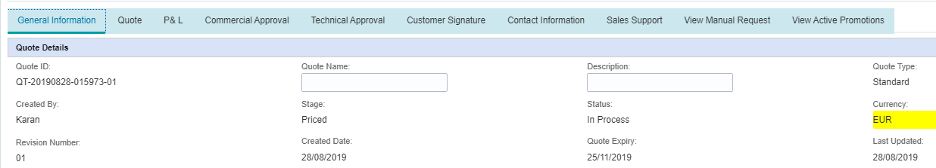


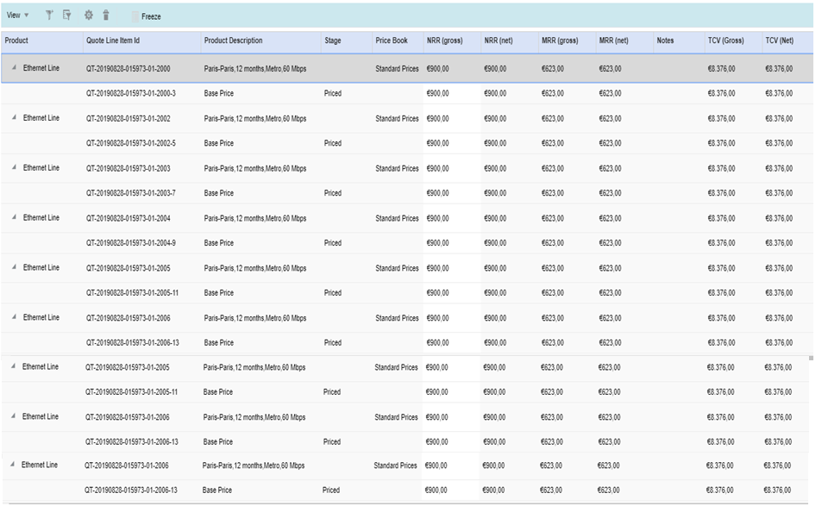
Standard quote
Options quote flag is available. This flag can be set or reset till commercial workflow is initiated.
QT-15973-01
Bundle Quote
QT-15973-2--01
QT-15973-3--01
QT-15973-4--01
QT-15973-5--01
QT-15973-6--01
QT-15973-7--01

Slide 36
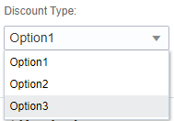

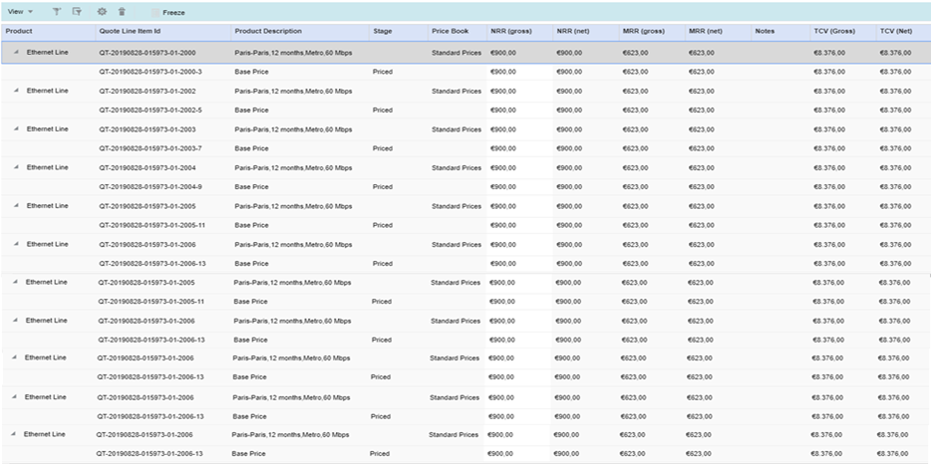

Create options in Standard quote
Options quote is set by user.
Number of options can be defined by user by default it would be 5.
Number of options can be change before initiating Commercial Approval.
It is mandatory to select options for each line item , system wont allow to proceed to next step till options is defined for each line item.
By Default Option1 is marked primary. It can be changed by user.
Only primary options details are synched with C4C.
Option feature is available only for Sales and Quoting desk.
If flag is reset options markings would be hidden.
Individual discount option is only available if channel is wholesale and quote type is price lookup.
Select primary option is not available for individual quote.
QT-15973-01
2
4
Bundle Quote
Number of Options
Select Primary Option
1
3
3
Options
Option Stage
QT-15973-2--01
Option 1
QT-15973-3--01
QT-15973-4--01
Option 1
QT-15973-5--01
QT-15973-6--01
Option 1
QT-15973-7--01
Option 2
Option 2
Option2
Option 3
Option 3
Option 3
Individual
Individual
Individual

Slide 37
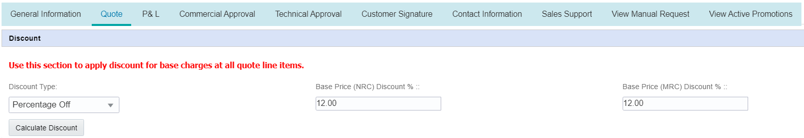
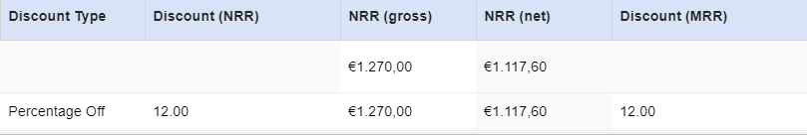

Apply Discount(Optional)
No Change in discount functionality.
Options
QT-15973-2--01
Option 1
QT-15973-3--01
QT-15973-4--01
Option 1
QT-15973-5--01
QT-15973-6--01
Option 1
QT-15973-7--01
Option 2
Option 2
Option 2
Option 3
Option 3
Option 3
Individual
Individual

Slide 38
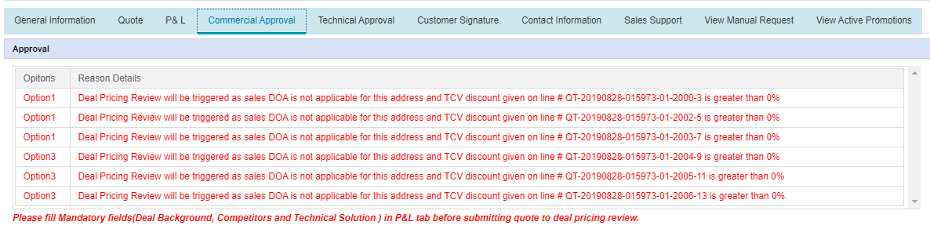

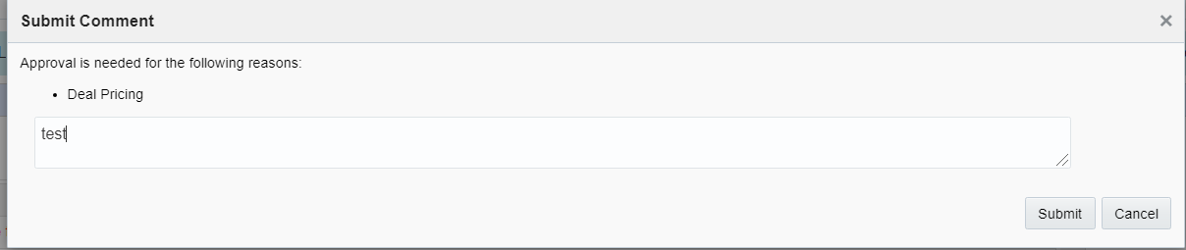

Submit for Approval(Showing scenario where Deal approval is required)
All line items should be in priced stage before quote can be submitted to deal pricing.
Reason table would show options which require approval from Deal/VP Sales.
All options would be submitted at same time.
All the options would go to only one approver. Highest approver would be selected for entire quote(all options).
Following is the list of Approvers in priority
Deal
VP Sales-1
VP Sales-2
Self Approval
1
Individual
Since one or more options requires Deal approval entire quote would be submitted to Deal.
3
2

Slide 39
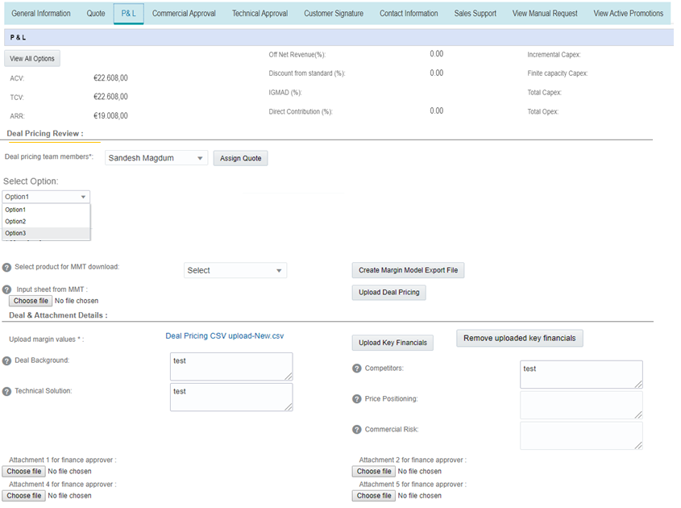

Option wise Deal pricing review
After Deal pricing team assignment, system will allow to select specific option to proceed MMT journey.
Deal Team would work on individual options i.e. upload MMT at option level.
Upload consolidated P&L sheet option wise.
Files, Deal background, competitors, Technical Solution, Price Positioning, Commercial Risk and attachment options are not available at option level. Its common for entire quote.
Individual
Note – Placeholder for message. Deal is responsible to get approval for all options.
1
2
Individual
3

Slide 40
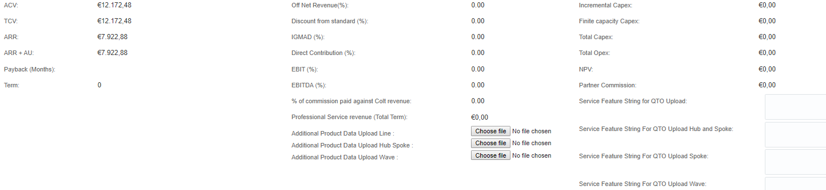
Option wise P&L
P&L Values will not set if MMT margin steps are not followed.
1
Individual

Slide 41
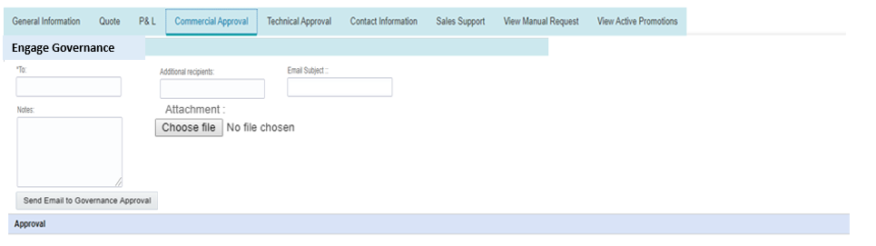
Send Email to Governance
Deal can initiate mail to governance.
By default system would populate the email id and subject.
Sender email id : Deal Pricing group email id.
User can add/edit email ids.
Key financials will get populated in email body for all the options in the same format as it is done for standard quote.
“Engage Governance” email activity is also logged in CPQ audit log.

Slide 42
Email Template to governance

Slide 43
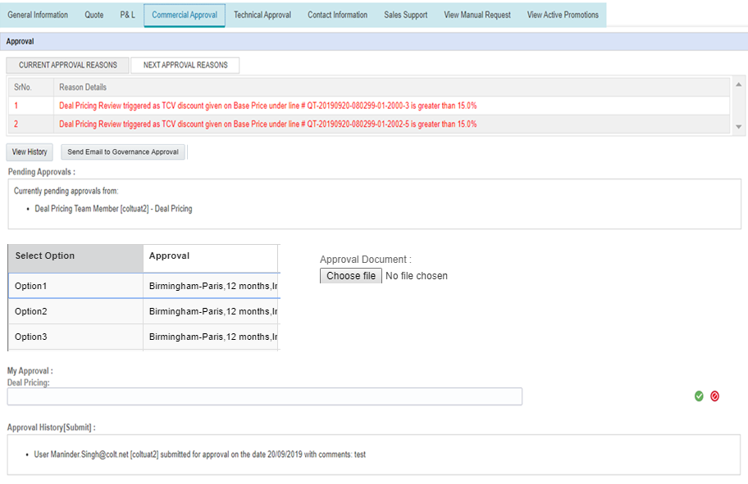


Deal Approval and Reject option wise & do approval at quote level
MMT is mandatory for those options for which Deal Approval is required.
On click on ‘Approve’ CPQ would validate if MMT is uploaded or not.
Deal team will approve or reject all the options individually .
For Approved system will validate P&L (if MMT is uploaded).
Deal Team has to approve/reject entire quote as well.
If Approve is clicked
At least one of the option should be approved.
User must have actioned all the options for approval or rejection.
User must attach approval artefact.
If Reject is clicked
All the options would be marked as rejected.
This action will override responses captured for individual option.
On Quote level Approval, existing validation of ‘Price Positioning’ and ‘Commercial Risk’ is done.
Status of options would be reflected in line item as soon it is entered for individual option.
All validations are available on quote level approve/reject not option level approve/reject.
All the options approval history would be maintain as part of Audit Histroy.
Options
Approval
2
1
Individual
3

Slide 44
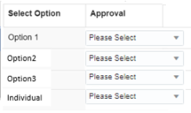
Deal Approval and Reject option wise & do approval at quote level
Deal team will approve or reject all the options individually .
For Approved system will validate P&L (if MMT is uploaded) at quote level approve.
Deal Team has to approve/reject entire quote as well.
If Approve is clicked
MMT is mandatory for those options for which Deal Approval is required.
At least one of the option should be approved.
User must have actioned all the options for approval or rejection.
User must attach approval artefact.
If Reject is clicked
All the options would be marked as rejected.
This action will override responses captured for individual option.
On Quote level Approval, existing validation of ‘Price Positioning’ and ‘Commercial Risk’ is done.
Status of options would be reflected in line item as soon it is entered for individual option.
All validations are available on quote level approve/reject not option level approve/reject.
All the options approval history would be maintain as part of Audit History.
Options
Approval
2
1
Individual
3

Slide 45

Quote is Commercially Approved
QT-15973-01
Commercially Approved
Bundle Quote
Options Quote
Options
Options Stage
QT-15973-2--01
Option1
Commercially Approved
QT-15973-3--01
Option1
QT-15973-4--01
Commercially Approved
QT-15973-5--01
QT-15973-6--01
Option1
Commercially Approved
QT-15973-7--01
Option3
Approval Denied
Option3
Approval Denied
Option3
Approval Denied
Individual
Commercially Approved
Individual
Commercially Approved
Individual
Commercially Approved

Slide 46



Create Quote (i.e. initiate Technical Approval) from Options
Only approved options will be listed in Technical approval tab to initiate technical approval.
For options quote with Opp new standard quote will be created in “Commercially Approved” stage.
For options quote without Opp new price lookup quote will be created in “Commercially Approved” stage.
All Financial data related to options will get carry forward to new quote.
User can initiate technical review for more than one option individually.
For Individual discount option line item needs to be selected to create the new quote. Multiple line items also can be selected, all selected line items would be part of one single quote.
Once one of the initiated quote is Accepted by Customer, opportunity is closed and all the associated open quote are closed(BAU).
All initiated quote stages would get reflected in Parent options quote.
Individual
Option
Options Status
QT-15973-2--01
Option1
Commercially Approved
QT-15973-3--01
QT-15973-4--01
Option1
Commercially Approved
QT-15973-5--01
QT-15973-6--01
Option1
Commercially Approved
QT-15973-7--01
Option3
Approval Denied
Option3
Approval Denied
Option3
Approval Denied
Individual
Commercially Approved
Individual
Commercially Approved
Individual
Commercially Approved

Slide 47
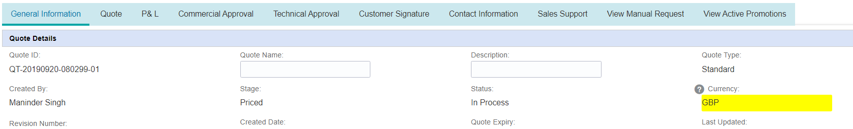
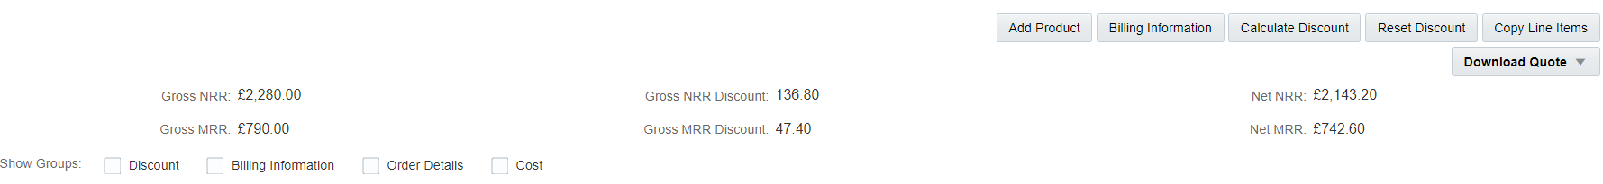
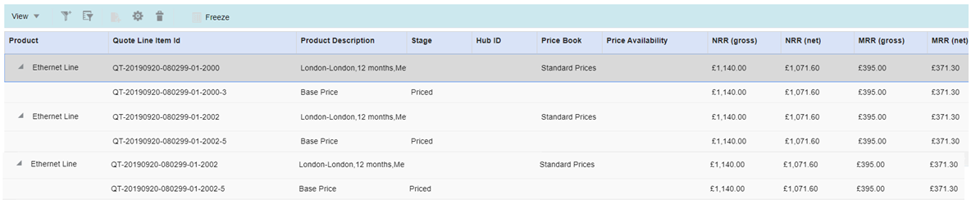
Standard Quote – New Quote is created in ‘Commercially Approved’ stage
Parent Line Item Id is displayed in grid. This would help to trace the parent line item.
Quote can be searched using this id.
QT-15973-2--01
Commercially Approved
Redirect to Parent Quote
Parent Line item Id
QT-15973-2-01-2-01
QT-15973-2-01-3-01
QT-15973-4-01-4-01
QT-15973-5—01-5-01
QT-15973-6—01-6-01
QT-15973-7—01-7-01

Slide 48
Case 2 – Options Quote pending with VP Sales-1
Case 2 – None of the options requires deal approval but one or more option required sales (VP Sales -1) Approval (Discount % 10 to 15 ).
Entire quote would be send to VP Sales -1 for approval.(User wont get an option to submit individual options to VP Sales)
VP Sales Approver
VP Sales would get email with all option details and approval and rejection can be given over email (Email template - TBC
) which would be reflected for all the options.
VP Sales can do the Approval or Rejection on CPQ. Its for the entire Quote, there is no provision to mark individual options as Approved or Rejected.
e.g. 1. If VP Sales approves quote then all the options would be mark as “Commercially Approved”.
2. If VP Sales reject the quote then all the options would be mark as “Approval Denied”
Add Few slides showing UI flow for Case 2.

Slide 49
Project Quote CPQ Journey: Staggered Delivery
Following slides depicts CPQ journey for staggered Delivery.

Slide 50

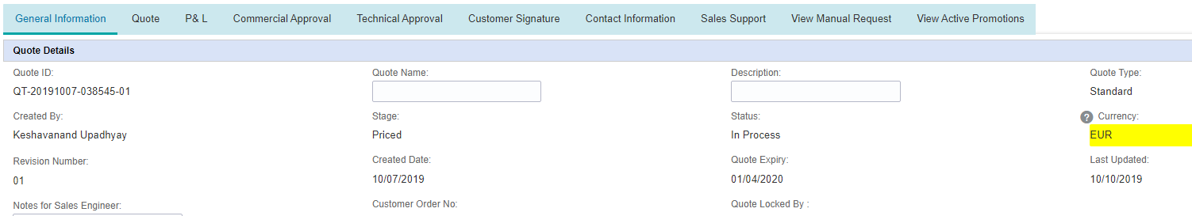




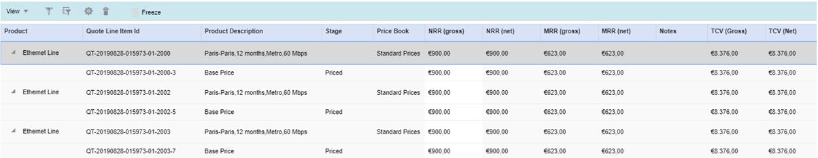
Standard Quote : Setting Project Quote Flag
QT-15973-01
Created
1
QT-15973-2--01
QT-15973-3--01
Created
QT-15973-4--01
QT-15973-5--01
Created
QT-15973-6--01
QT-15973-7--01
Created

Slide 51
Project Quote – Commercially Approved
QT-15973-01
Commercially Approved
QT-15973-2--01
QT-15973-3--01
QT-15973-4--01
QT-15973-5--01
QT-15973-6--01
QT-15973-7--01

Slide 52

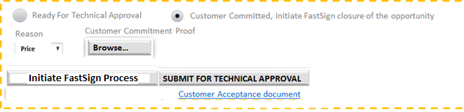
Standard Project Quote – Use Fast Sign process to close the opp
1
Close Fast sign Process
2
QT-15973-2--01
QT-15973-3--01
QT-15973-4--01
QT-15973-5--01
QT-15973-6--01
QT-15973-7--01

Slide 53
Standard Project Quote – Initiate Staggered delivery
2
Submit for Technical Approval is available only after Fast Sign process is complete. This is two step process 1) Completed Fast Sign Process and 2) Initiate Technical Review for Specific line items.
2
QT-15973-2--01
QT-15973-3--01
1
QT-15973-4--01
QT-15973-5--01
QT-15973-6--01
QT-15973-7--01

Slide 54
Standard Quote – Commercially Approved
QT-15973-2--01
Commercially Approved
Redirect to Parent Quote
QT-15973-2-01-2-01
QT-15973-2-01-3-01

Slide 55
Standard Quote – Ordered
QT-15973-2--01
Ordered
Redirect to Parent Quote
QT-15973-2-01-2-01
QT-15973-2-01-3-01

Slide 56
Standard Project Quote – All line items are Ordered
Project Quote stage is ordered when all the individual line items are reached to ordered stage.
At this stage Project Quote is closed.
Intermediate Stages are not reflected at Quote level. i.e. Project Quote move directly from ‘Commercially Approved’ stage to ‘Ordered’ stage.
At line litem level , all stages are reflected from standard quote to Project Quote.
QT-15973-01
Ordered
Closed
Quote ID
Quote Stage
QT-15973-2--01
QT-15973-2--01
Ordered
QT-15973-3--01
QT-15973-4--01
QT-15973-4--01
1
Ordered
QT-15973-5--01
QT-15973-6--01
QT-15973-6--01
Ordered
QT-15973-7--01

Slide 57
CPQ Transaction Level Reports
List of all Project Quotes
Quote ID
Type of Quote e.g. standard or price lookup
Stage of Quote
Status of Quote
Fast Sign status
Total number of line items
Opp ID
Opp Status
Sales Channel
Technical delivery initiated or not
Pending line items not initiated for technical delivery
Number of line items ordered
Deal Pricing engage
Project quote creation
Last updated date
2. List of all Options Quote
Quote ID
Type of Quote e.g. standard or price lookup
Stage of Quote
Status of Quote
Opp ID
Opp Status
Sales Channel
Count of line items(quote level)
Deal Pricing engage or not
Number of options
Number of approved options
Number of rejected options
Primary Option
Number of Options initiated for technical delivery

Slide 58
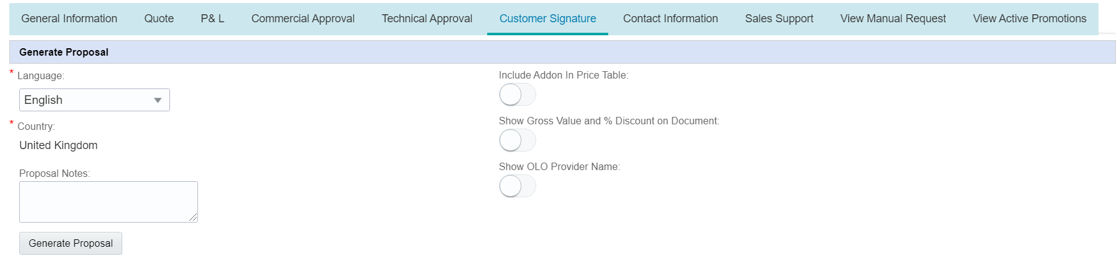
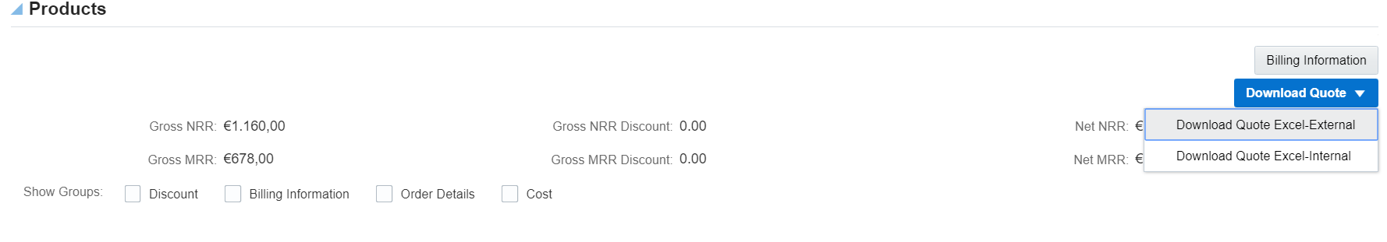
Proposal
For Options Quote add a note:
Note – For options quote it is recommended to use Download Quote Excel.

Slide 59
Download Quote Excel
Additional column in excel download to indicate the option

Slide 60
System Impacts

Slide 61
CPQ
Develop new Capabilities for Options, Project Quote, Price Lookup Quote and other Generic enhancements.
Pls refer the slide deck for details.

Slide 62
C4C/WM
In terms of impact, there are two key parts
New flags and Validations:
To pass Project quote and Options Quote flag from CPQ->WM->C4C.
C4C to display Quote Category flag at Quote level. It should be next to Quote type column in below C4C views.
Quote Detailed Screen
Opportunity > Quote Tab
Account > Quote Tab
Quotes List Screen
Price Lookup Project Quote can’t be associated with Opportunity. C4C to restrict it.

Slide 63
C4C/WM
Spawning Related impact
At present Spawning is done in MQ quote but now Spawning would be used in Project Quote and Options Quote as well. Using Spawning Flag, Quote stage =( Priced or commercially Approved) it is decided whether to create new Opportunity and WM sends back the new Opportunity details to C4C. this logic needs change to accommodate Project Quote and Options Quote. This impact both C4C and CPQ.
Following describes the Spawning behaviour in different Quotes. We need to come up a common logic which can cater to all scenarios.
MQ quote
child Quote is created with new opportunity
Options Quote:
If parent Quote has opportunity, Child Spawned Quote is created with same Opportunity.
If Parent Quote is price lookup quote (i.e. without Opportunity), child Quote is created without opportunity.
Project Quote:
If parent Quote has opportunity, Child Spawned Quote is created with same Opportunity.
If Parent Quote is price lookup quote (i.e. without Opportunity), child Quote is created with new opportunity.
Proposed Approach for Spawning:
CPQ sends
‘Is Spawned’ existing attribute with following set of values
No
Yes with New Opportunity
Yes with Existing Opportunity
Existing Opportunity Id if present.
Change the datatype of existing ‘Is Spawned’ Attribute and use it to indicate different set of scenarios. This would require regression on MQ part.
C4C picks the values and based on ‘Is Spawned’ Attribute determine whether to create new opportunity or not.
Based on ‘Is Spawned’ Attribute WM decides whether to update the Opportunity Id back to CPQ.
One Spawned Quote is created then ‘Is Spawned’ should be set to ‘No for any further integration calls.

Slide 64
C4C/WM
Spawning Related impact
Flag Name : isOppRequired
This flag has to be sent from CPQ via WM
Flag type : Indicator holding Yes/NO value
The flag has to be sent from CPQ as
Yes : When the opportunity is to be created in C4C
No : When the opportunity is not to be created in C4C.
This way we shall not use the existing logic of having a look on the quote stage. C4C will fully dependent on the value sent from CPQ.
This we need to create in Quote and expose it in the Manage quote WSDL for WM to map.
Also CPQ has to make sure once the flag value is sent as Yes, from the next update onwards CPQ need to take care of making the value as No, so that again a new opportunity shall not be created.
Proposed Approach for Spawning:
Quote | wM Logic Flags | Fields | Opportunity Id
MQ Quote | quote:isSpawnedQuote=Yes | Existing | No
 | quote:isOppRequired=Yes | New
Options Quote(Parent with Opp) | quote:isSpawnedQuote=Yes | Existing | Yes
 | quote:isOppRequired=No | New
Options Quote(Parent Without Opp) | quote:isSpawnedQuote=Yes | Existing | No
 | quote:isOppRequired=No | New
Project Quote(Parent with Opp) | quote:isSpawnedQuote=Yes | Existing | Yes
 | quote:isOppRequired=No | New
Project Quote(Parent without Opp) | quote:isSpawnedQuote=Yes | Existing | No
 | quote:isOppRequired=Yes | New

Slide 65
C4C Screens

Slide 66
Additional slides

Slide 67
Moving Opportunity to different OCN: Rules on C4C
 |  | Is OCN Change allowed on c4c?
 | Quote Stage | Same Pricing Segment | Diff Pricing Segment | Same Sales Channel | Diff Sales Channel | Same Colt Org Country | Diff Colt Org Country | CPQ Behaviour
Opp Without Quote | NA | Yes | Yes | Yes | Yes | Yes | Yes
Opp With Quote | Created | Yes | Yes | Yes | Yes | Yes | Yes | IF OCN change is done within same price impacting parameters then new OCN related details will get updated once quote is reopened. If OCN change is done with different price impacting parameters then system will show refresh all message on opening quote and Refresh All button is available.
 | To Be priced | Yes | Yes | Yes | Yes | Yes | Yes
 | Waiting for third party | Yes | Yes | Yes | Yes | Yes | Yes
 | Waiting for BCP | Yes | Yes | Yes | Yes | Yes | Yes
 | Deal pricing review required | Yes | Yes | Yes | Yes | Yes | Yes
 | Rejected by PPT | Yes | Yes | Yes | Yes | Yes | Yes
 | Portfolio pricing review | Yes | Yes | Yes | Yes | Yes | Yes
 | Priced | Yes | Yes | Yes | Yes | Yes | Yes
 | Deal Pricing Review | Yes | Yes | Yes | Yes | Yes | Yes | If OCN change is done with same price impacting parameters then system will show refresh all message and deal user has to reject quote.
 | Commercially Approved | Yes | No | Yes | No | Yes | No | IF OCN change is done within same price impacting parameters then new OCN related details will get updated once quote is reopened.
 | SE Technical Review | Yes | No | Yes | No | Yes | No
 | CST Technical Review | Yes | No | Yes | No | Yes | No
 | Approved | Yes | No | Yes | No | Yes | No
 | Sent to Customer | Yes | No | Yes | No | Yes | No
 | Accepted by Customer | Yes | No | Yes | No | Yes | No

